Slide 1
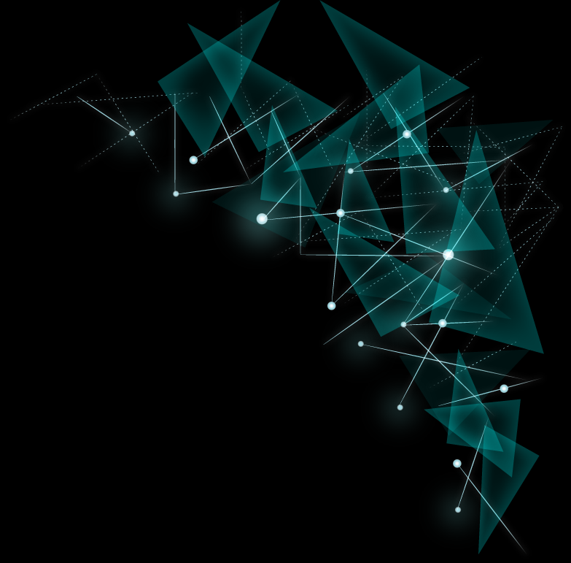
Recommendation System
--Using Spark Platform
Group Member:
Xie, Yiding
Xing, Yang
Zhou, Zhibo

Slide 2
Outline
Data
Eco-system
Alternating Least Squares
Performance

Slide 3
Data| PART1

Slide 4

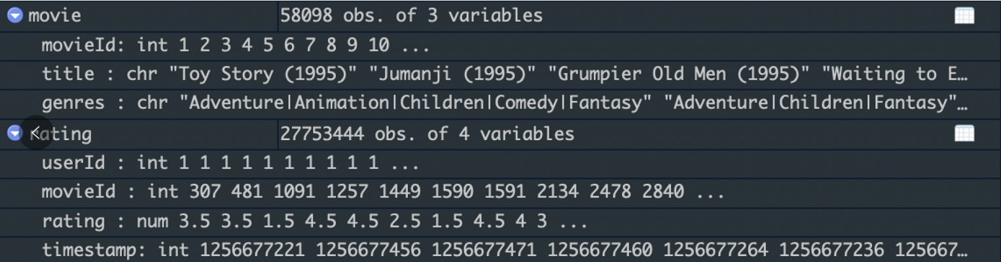
Data Source:
https://movielens.org/

Slide 5
Eco-System| PART2

Slide 6
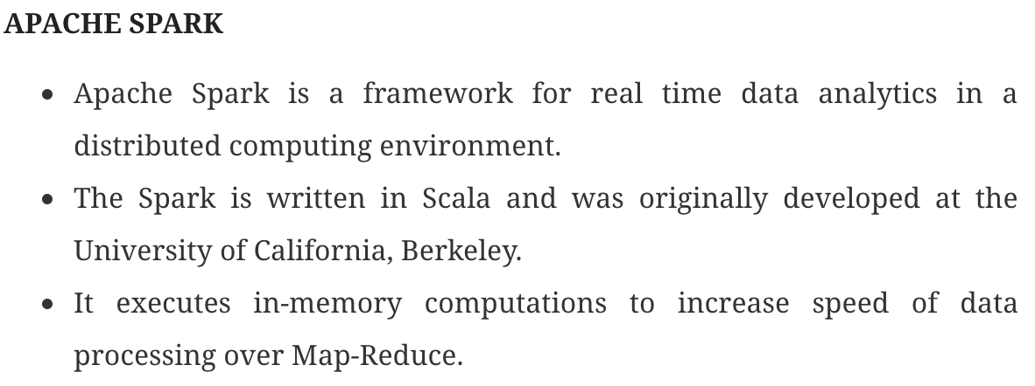
Spark Ecosystem
Notes:
Consider YARN as the brain of your Hadoop Ecosystem. It performs all your processing activities by allocating resources and scheduling tasks.
ResourceManager is again a main node in the processing department.
NodeManagers are installed on every DataNode. It is responsible for execution of task on every single DataNode.

Slide 7
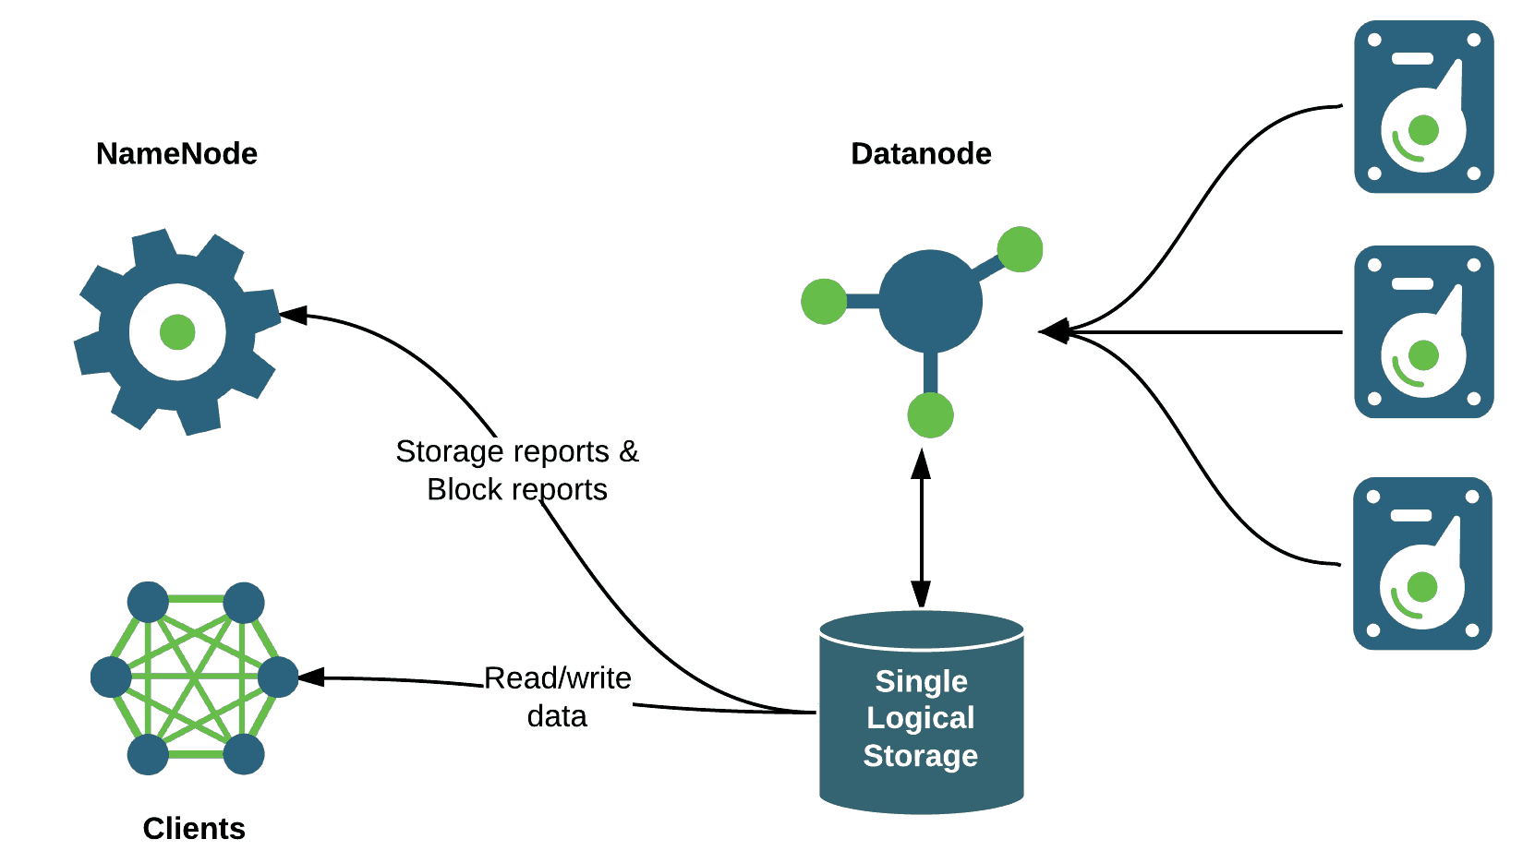
Hadoop Distributed File System
The NameNode is the main node, it doesn’t store the actual data.
DataNodes is where data stored, hence it requires more storage resources.
Clients always communicate to the NameNode while writing the data.

Slide 8
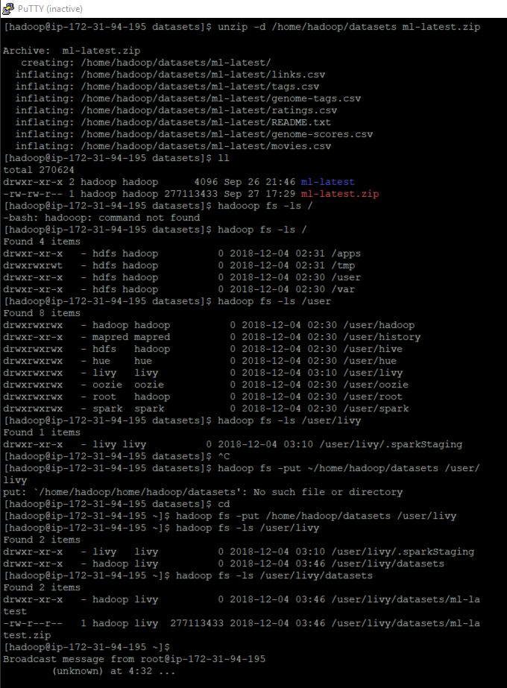

Slide 9
Alternating Least Squares | PART3

Slide 10
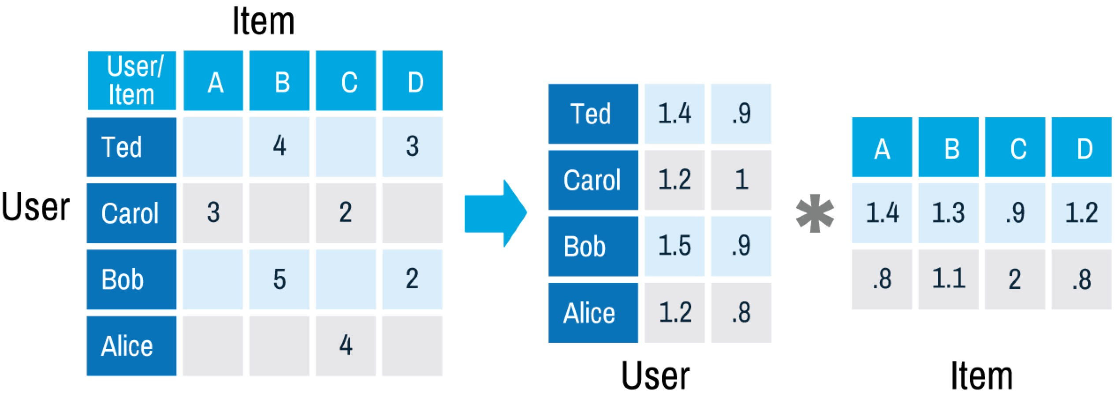
Main Idea of ALS
m
k
m
n
k
n
Number of user (n): 27,753,444
Number of item (m): 58,098

Slide 11
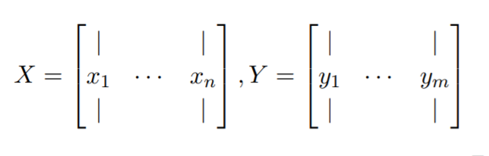

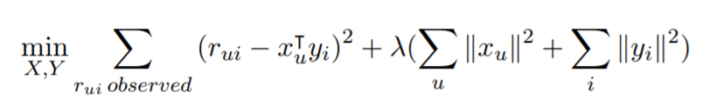
General Idea
1.
If there are n users and m items, we are given an n × m matrix R in which the (u, i) th entry is rui – the rating for item i by user u.
2.
3.
4.

Slide 12
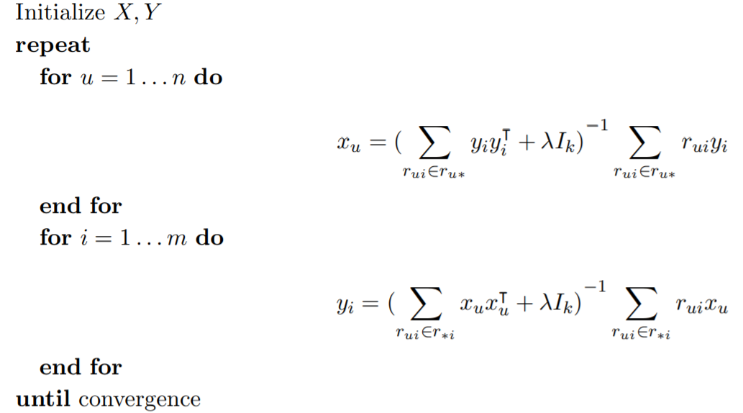
Algorithm

Slide 13
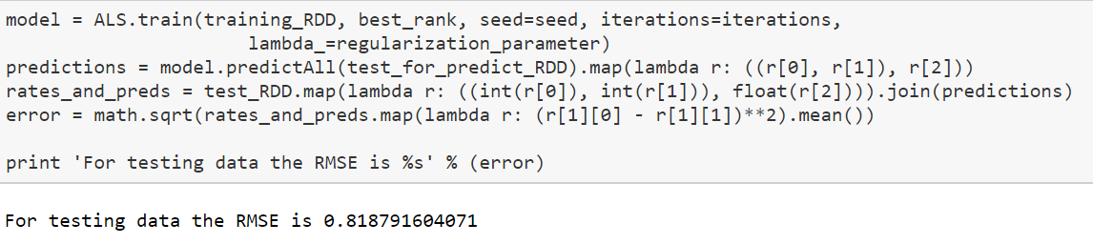
Implementation
(From Pyspark.MlLib)

Slide 14
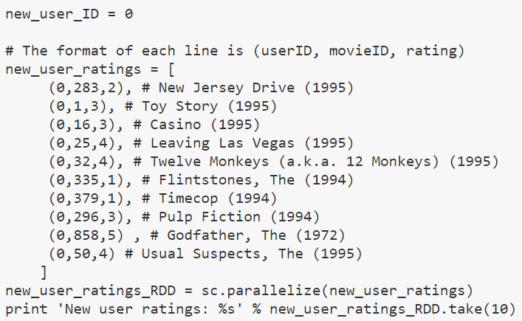
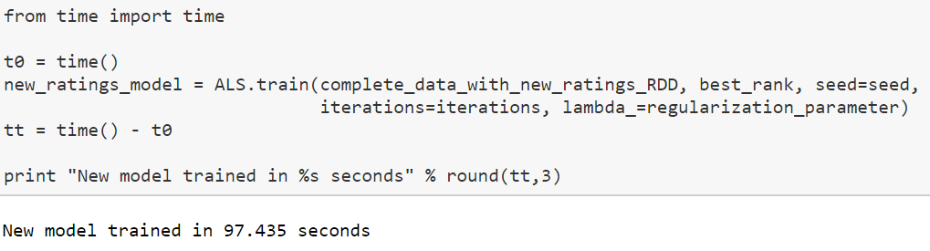

Slide 15
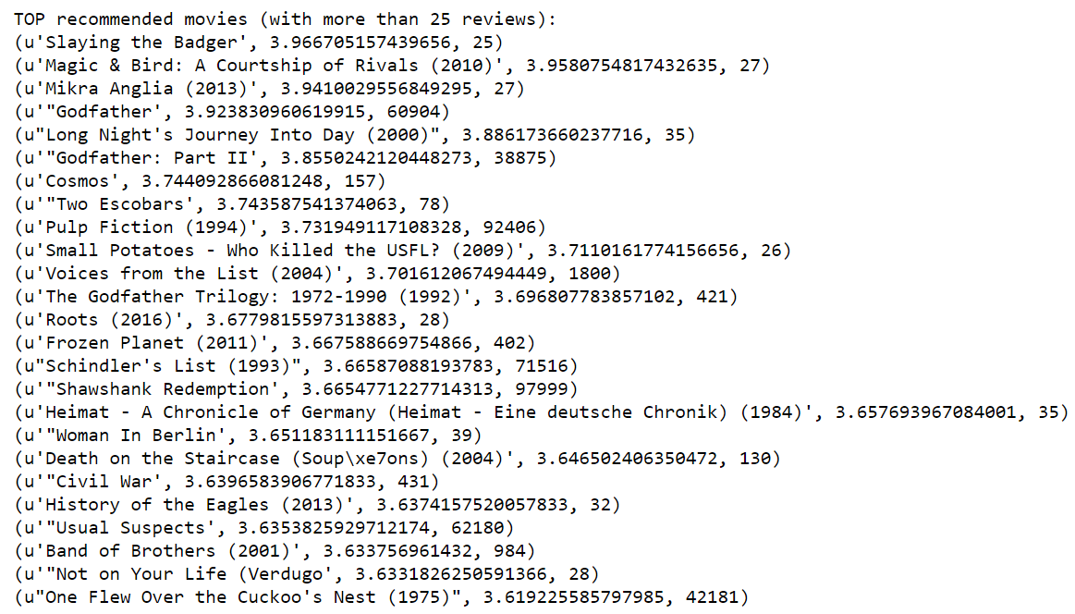
Recommendation

Slide 16
Performance| PART4

Slide 17
Performance
The Netflix Prize:
Given the training data
100 million ratings
Rating Scale: 1-5
Netflix’s system
RMSE: 0.9514
Our model:
Given the training data
Number of user: 27,753,444
Number of item: 58,098
Rating Scale: 1-5
RMSE: 0.8188

Slide 18
Journey
– Google Cloud Platform(GCP)
– Single Machine
– 16 Core, 96G RAM
– ALS algorithm, out of memory
– Amazon Web Services(AWS) EMR
– One master and three slaves, each machine has 16 core, 96G RAM
– Total Running Time : 97s
Google Cloud Platform
Amazon Web Services

Slide 19
Reference
http://stanford.edu/~rezab/classes/cme323/S15/notes/lec14.pdf
https://datasciencemadesimpler.wordpress.com/tag/alternating-least-squares/
https://www.edureka.co/blog/hadoop-ecosystem

Slide 20
| THANK YOU

